Slide 1



Tencent Cloud EdgeOne
Edge Security & Acceleration Platform
Secure | Reliable| Fast | Professional
2022.07
EdgeOne Product Team

Slide 2
Introduction
Capabilities
Key Advantages
Case Sharing
Agenda

Slide 3
01
Introduction

Slide 4






Gaming
E-commerce
Tencent Cloud EdgeOne
Tencent Cloud EdgeOne is an integrated edge service platform for global markets, providing best in class web security and user experiences.
Tencent Cloud EdgeOne integrates Tencent's years of security experience to provide protection against most sophisticated threats including DDoS, Web attack and Bot, while delivering superior experiences.
The game suffered a DDoS attack that prevented players from logging in.
An e-commerce website hacked: 1.1 Million Account Information Lost.
Finance
OTT
A number of brokerages suffered DDoS attacks and reported a total loss of 20.6 billion.
The destruction or disappearance of a large number of music MVs.
Ticket
Hospitality
A data breach occurred on the ticketing website, resulting in the disclosure of the personal information of more than 130,000 citizens.
The payment systems of a hotel in 11 countries around the world were hacked, and a large amount of data was leaked, including guest payment card names, card numbers, expiration dates and verification codes.

Slide 5

Tencent Cloud EdgeOne Qualification Certification
PCI DSS
K-ISMS
PCI DSS Level 1 Service Provider
Joint third-party evaluation agency ATSEC to provide security compliance services around the world
Korea Information Security Management System
The third company in the world after Amazon and Microsoft
GDPR
CSA STAR
Comply with EU GDPR user data protection rules
International Cloud Security Alliance Gold Level Certification
HIPAA
ISO 27701
Publish the HIPAA Self-Assessment Report
Passed the requirements of ePHI on protecting the security and privacy of user information
The world's first cloud service provider certified by ISO/IEC 27701:2019 personal privacy security protection
MTCS
CISPE
Certification to Singapore Multi-Tier Cloud Security (MTCS) T3 Level Standard
The first company in China to be certified by the European Cloud Computing Service Providers Alliance Personal Data Protection Code of Conduct
Notes:
PCI SSC 是由美国运通（American Express）、美国发现金融服务（Discover Financial Services）、JCB、万事达（Master Card Worldwide）和 Visa 国际组织五家支付品牌主导的支付卡行业数据安全标准

Slide 6
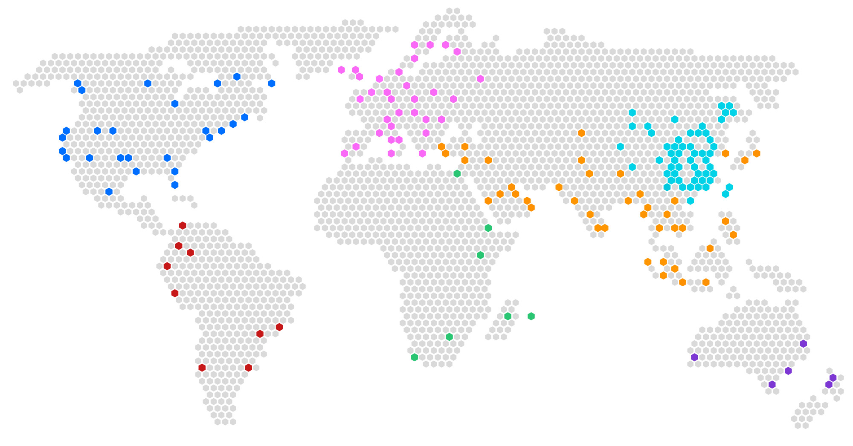
EdgeOne Platform Capacities
2800+
Edge Nodes
Daily Mitigation of malicious requests
20 mil+
Peak QPS
30 mil+
70+
Countries/Regions
Average Daily Requests
2 trillion+
160T+
Reserved Bandwidth
China
Asia
Europe
Africa
North America
South America
Oceania

Slide 7
Tencent Cloud EdgeOne Architecture
EdgeOne Nodes
Edge Nodes
Regional Nodes
EdgeOne Intelligent DNS
Security
Acceleration
Multiple Tiers
Distributed platform
PC
Volumetric
DDoS mitigation
Smart Acceleration for dynamic and static content
Improve hit rate
Normal request
DDoS mitigation
Smart Rate Limiting
Performance optimization
Mobile
Reduce the request load of the origins
Protocol optimization
Origins
Smart Acceleration
Web Protection protection
PC
Network acceleration
Real-time link
monitoring
Best network performance to origins
Malicious request
Bot Management
Audio & Video acceleration
Mobile
Notes:
把这一页做成两个层级的

Slide 8










Tencent Cloud EdgeOne Integrated platform advantage
Performance optimization
Security
Data Intelligence
Site Acceleration
Smart Acceleration
DDoS
Mitigation
Web Protection
Security Situational Awareness
Performance monitoring
SSL/TLS
DNS
Load balancing
Bot Management
L4 Proxy
Log service
Traffic Analysis
Integrated edge security acceleration platform
Rich global resources and intelligent acceleration
Centralized management by policy and integrated protection
Easy access to services and flexible configuration

Slide 9
02
Capabilities

Slide 10
Tencent Cloud EdgeOne -- Site Acceleration
One-click to quickly enable network/page/file optimization and other capabilities to minimize network latency and improve site loading speed
Tip
Rule engine
Flexible custom rules for caching, optimization and origin settings
DNS
Load balancing
Distributed and fastest resolution
Flexible policies based on geo, load and performance
North American users
European users
Origins
Global network
Network Optimization
Page optimization
Smart Acceleration
Asian users
70+ countries and regions
800+ global pops
TLS 1.3, HTTP/2 and HTTP/3 (QUIC)
Page optimization tool set
Faster, more stable and Secure
Notes:
把这一页做成两个层级的

Slide 11



Tencent Cloud EdgeOne -- DNS Capabilities
Fast domain setup experience, provide professional and stable DNS resolution service, one-click to enable security & acceleration feature.
High-Availability and Security
Years' experience of serving Tencent Cloud and internal business, with a peak QPS of 100W and a daily request volume of 50 billion.
Multiple Anycast IP ranges to achieve high availability.
Capabilities
Associated with security protection/site acceleration function, simple setup
Support NS or CName onboarding
Performance
Deployed in dozens of distributed IDCs to achieve best performance, with an average delay of 30ms
Over 10Tbps DDoS mitigation capacity, service capacity of 100 million QPS
Tip
EdgeOne DNS
Intelligent Scheduling
DNS Only
NA Users
North America Clusters
NA Origin Server
Intelligent Scheduling
DNS Only
EU Users
European Clusters
EU Origin Server
Intelligent Scheduling
Site Acceleration
EdgeOne Overseas Network
Middle East Users
Middle East Clusters
Middle East Nodes
Middle East Nodes
Origin Server

Slide 12

Tencent Cloud EdgeOne -- Load Balancing
Load balancing based on different regions or weights supports binding origin health monitoring tasks and intelligently and dynamically distributes origin-pull traffic to ensure overall service availability
Tip
Change NS or CNAME to enable EdgeOne service
High Availability
WebSite
Static Resources
EdgeOne can achieve High Availabitliy by avoiding faulty origin servers and load-sharing among origin servers through intelligent algorithm.
html
css
js
jpg
apk
mp4
zip
…
Intelligent Traffic Assignment
Dynamic Resources
User A
CDN Server（Region1）
API
jsp
asp
php
Caching Static Resources
Accelerate Dynamic Request
perl
cgi
...
Load Balancing
Origin Server 1
User B
CDN Server
（Region 2）
WebSite
Origin Group
Caching Static Resources
Accelerate Dynamic Request
Intelligent Traffic Assignment
Static Resources
EdgeOne can achieve flexibility by introducing Origin Groups to manage individual Origin servers, and Origin Group can be used in different modules.
css
jpg
User C
CDN Server
（Region 3）
html
css
js
apk
mp4
zip
…
mp4
Dynamic Resources
API
jsp
asp
php
perl
cgi
...
Origin Server 2

Slide 13





Tencent Cloud EdgeOne -- Smart Acceleration
One-click intelligent acceleration, intelligent routing optimization, and efficient support for latency-sensitive services
Tip
Fast response to requests
Using realtime and whole network status to select the optimal network paths while avoid poor or congested links, thus improve response time and page load time
Static Resources
html
css
js
jpg
Tencent Cloud EdgeOne Network
Innovative Protocol Optimization
apk
mp4
zip
…
Spread across more than 70 countries and regions, with 800+ locations and a total reserved Bandwidth more than 100Tbps
Make full use of all available bandwidth resources to achieve stable network transmission and better network performance
Dynamic Resources
API
jsp
asp
php
Origin Server
perl
cgi
...
Network Congestion
Internet Nodes
源站服务器
Unstable network
Improve Performance
Smart Acceleration technology select the optimal network path according to realtime network status, thus minimizing network delays, connection errors, and request failures.
The recovery time of packet loss is increased by 33% compared to original TCP, and the average first mile performance is increased by at least 30%.

Slide 14


Tencent Cloud EdgeOne -- Layer 4 Proxy
Provides client-level DDoS protection and Layer 4 acceleration services for TCP/UDP applications through smart scheduling, edge DDoS mitigation, and intelligent routing technologies.
Tip
Availability and Security
Awareness to DDoS attacks through customer-level DDoS protection, monitoring and custom policies.
Network acceleration
Provide high-availability and low-latency application acceleration services via layer 4 port forwarding while ensuring security.
Provide 2 methods for onboarding: Anycast (static IP) or CNAME.
Layer 4 Proxy Network
Anycast Scheduling
NA Users
North America Clusters
Endpoint Node
Optimal path to Origin
Anycast Scheduling
Fast Tunnel
EU Users
European Clusters
Intelligent Routing
Endpoint Node
Listener
Origin Server
CNAME Scheduling
Middle East Users
Middle East Clusters
Endpoint Node

Slide 15
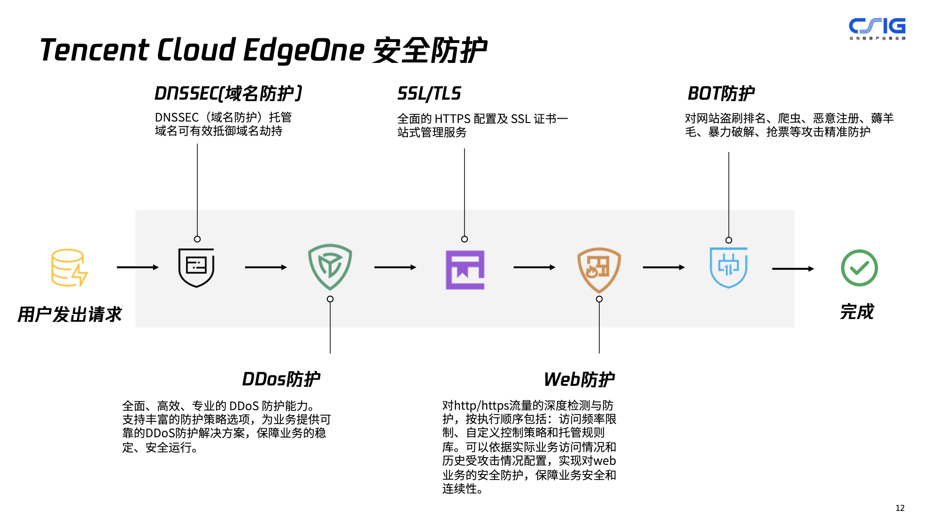






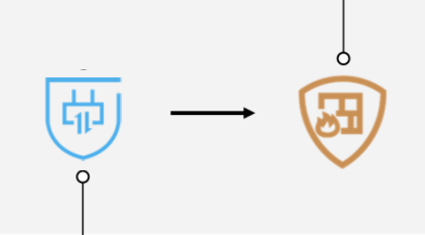
Tencent Cloud EdgeOne 安全防护
Tencent Cloud EdgeOne -- Security
DNSSEC(域名防护）
SSL/TLS
Bot防护
Integrated security products, provide a complete protection system, and comprehensively protect site services
Tip
DNSSEC（域名防护）托管域名可有效抵御域名劫持
全面的 HTTPS 配置及 SSL 证书一站式管理服务
对网站盗刷排名、爬虫、恶意注册、薅羊毛、暴力破解、抢票等攻击精准防护
Web Protection
DNSSEC
SSL/TLS
DNSSEC: Domain Protection, prevents domains from DNS poisoning and hijacking.
Indepth inspection and protection of HTTP/HTTPS traffic, to achive high-level security and business continuity.
One-stop SSL certificate management and HTTPS configuration.
用户发出请求
完成
User's Request
Web Acceleration
DDos防护
Web防护
全面、高效、专业的 DDoS 防护能力。支持丰富的防护策略选项，为业务提供可靠的DDoS防护解决方案，保障业务的稳定、安全运行。
对http/https流量的深度检测与防护，按执行顺序包括：访问频率限制、自定义控制策略和托管规则库。可以依据实际业务访问情况和历史受攻击情况配置，实现对web业务的安全防护，保障业务安全和连续性。
DDoS Protection
Bot Management
Comprehensive, efficient and accurate DDoS mitigation solution. Flexible DDoS mitigation strategies can be deployed to ensure safe and robust access
Precise protection against website frauds, crawler, malicious registration, brute force cracking, inventory grabbing and other attacks.

Slide 16
Tencent Cloud EdgeOne -- DDoS Protection
Accurate and reliable DDoS attack detection, combined with distributed architecture and multi-level protection mechanism, to achieve efficient DDoS mitigation
Tip
Global Data Centers for Safe Access
Global data centers with Anycast access, close to the origin, and protect your origin server’s stability and reliability
Typical L4 Attacks
UDP Flood
SYN Flood
TCP Flood
ICMP Flood
Normal Access
ACK Flood
FIN Flood
…
Attack
New types attacks and 0-day attacks
TCP open connection
Access Granted
DNS/NTP/SSDP amplification
TCP Reflection
…
Quick and accurate protection
Protect the Origin
Reliable detection of growing types attacks
Detect and mitigate resource exhaustion attacks in L4 transport layer and L7 application layer
Time to mitigate within seconds
Industry-leading mitigation algorithms for TCP Reflection Attacks
Option to detect and block attacks based on the attackers' device fingerprint
Watermark authentication (optional ) for TCP and UDP packets

Slide 17

EdgeOne – Web Protection/Bot Management
The world's leading web protection capabilities and mature Bot management capabilities ensure the security, stability and reliability of web services
Tip
Request
Rate Control
Access Granged
Bot Management
Web Policy Engine
Extensive protection against Web Protection attacks
Web attack recognition defends effectively against common web attacks including the OWASP top 10 risks. protected users can get zero-day and emergency vulnerability protection instantly and automatically
Bot identify and Management
Precise Bot identification and management based on the Protocol Characteristics/IP Reputation/Session characteristics by using AI technology to model and learn using Tencent's massive data and threat intelligence to intelligently identify undisclosed and malicious crawler programs and crawler traffic.

Slide 18
Tencent Cloud EdgeOne -- Data Intelligence
Provide customers with more fine-grained performance and security various statistical data and report viewing functions, help customers quickly understand security situation and attack trends, and understand business data from multiple dimensions
Tip
Security situational awareness
Performance monitor
Provide multiple performance metrics based on the realtime cloud-based automation test tools, then give customers optimization suggestions, to help the customer achieve continuous performance excel
Real-time protection report and analytics on security threat trends and events, include DDoS attacks and Web Protection attacks.
Data Analytics
Real-time Logs
Empower the customer to have the insight of the multi-dimensional business metrics and performance metrics based on the realtime log analysis.
Realtime log collection and delivery, fast retrieval and analysis of log data.
Metric at a Granularity of One minute
Multi-dimensional Metrics
Realtime Log Analysis
Real User Performance Monitoring (coming soon)
18

Slide 19
03
Key Advantages

Slide 20




Anycast based Security Protection
By leveraging the strengths of Anycast architecture, EdgeOne offers a global protection capability of 10 Tbps (5+Tbps currently).
  Traditional scrubbing architecture
  EdgeOne architecture
Global protection
Up to 10 Tbps
The next node will be scheduled
Attacks
One single node can't resist attacks
Attacks
Nodes are intruded one by one
  Attack protection relies on the protection capabilities of individual nodes. General nodes and large central nodes offer 10–100 and 200–800 Gbps protection respectively.
  Large-scale attacks can easily damage the business. As the protection capacity of individual nodes is low, when they are attacked, there will be the risk of continuous scheduling, which will greatly increase the latency.
  EdgeOne adopts the Anycast architecture to perform near-origin scrubbing when under attack. The aggregate protection capability can reach 10 Tbps, far exceeding the largest DDoS attack ever recorded (3.45 Tbps).
  EdgeOne can identify and mitigate most DDoS attacks within few seconds, with a 99.9% attack mitigation efficiency.

Slide 21




Hybrid mode with Anycast & Unicast
The innovative architecture design ensures business security while greatly improving the performance
  Global AnyCast architecture
  EdgeOne architecture
Anycast
General access
Anycast
8%
Intelligent DNS
Concurrent
surges
100%
100%
Origin
Origin
100%
5%
Unicast
General access
100%
General access
100%
10%
EdgeOne
Normal access path
Detour caused by Anycast's inability to schedule nodes
  If the traffic surges or the load of a data center runs into a bottleneck, Anycast cannot eliminate and schedule the data center in time, which leads to detours for some users and thus a poor experience.
  Relying on ISP coverage, it is difficult to optimize for regional nodes, and the performance is compromised.
EdgeOne uses DNS+BGP hybrid smart DNS to precisely schedule and direct large traffic surges to Unicast edge servers, greatly improving the performance during steady access.
As shown above, the performance of the EdgeOne architecture is increased significantly based on Anycast in the non-attack state.
*Source: Automated testing data from Catchpoint

Slide 22
Rich experience in large-traffic business services, with precise scheduling to sustain business surges
Ecommerce and new retail
Gaming
Ecommerce
Short video
A blockbuster mobile FPS game with a large number of players at home and abroad uses Tencent Cloud solutions:
A well-known ecommerce platform leverages Tencent Cloud solutions to support various promotion campaigns:
A top UGSV platform with high numbers of daily active users and brand awareness around the world adopts Tencent Cloud solutions:
20 Mbps
20%
3.59 million QPS
Download speed increased to
Lag rate decreased by
15%
Resisted attack peak
(Data dated December 12, 2021)
50%
Resource loading time reduced by
Playback failure rate decreased by

Slide 23





Direct Connect and Dedicated Link
In-depth integration with cloud to deliver a higher stability, security, and flexibility solution
  Independence of ISPs for a stable and excellent performance
  Security with no origin exposures
  More flexible scheduling
  Regional central node
  interconnection over Direct Connect
  Origin (Tencent Cloud)
  CVM
  COS
  CLB
  VPC
  OCI
  User
  Edge Node
  Support for separate
  purchase of Direct Connect
  Regional central node
  Origin (external)

Slide 24
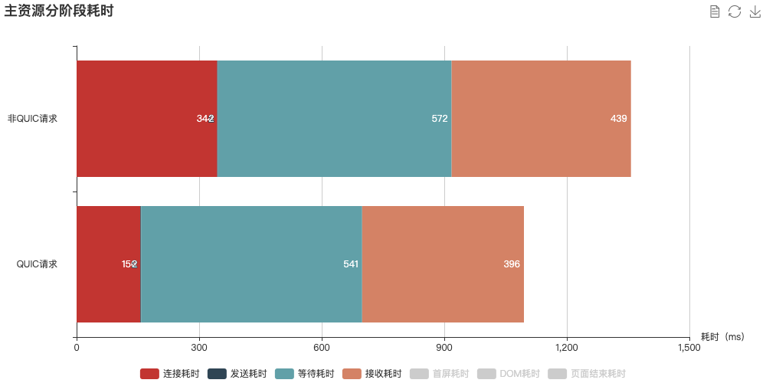
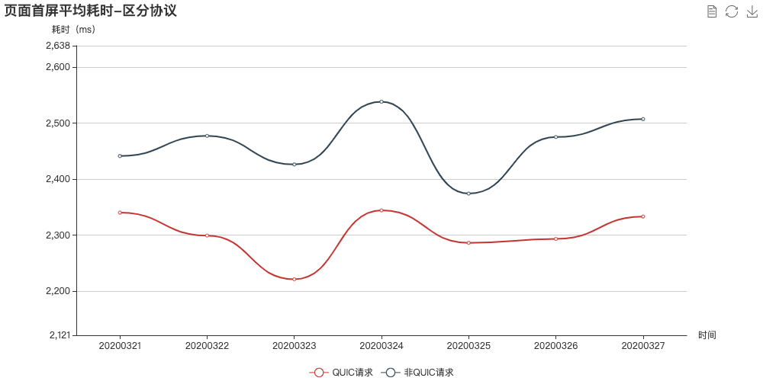
Comprehensive Protocol Coverage
EdgeOne offers the most complete protocol coverage and is the world's first to support QUIC for both SDKs and servers.
Transfer protocols
Push protocols
Playback protocols
TCP / UDP / HTTP / HTTPS / QUIC
RTMP / RTMPS / WebRTC / SRT / QUIC
RTMP / FLV / HLS / WebRTC / Dash
  Two-way collaboration & supports QUIC for both SDKs and servers
  Better performance and stability with dedicated transfer optimization
Independent TQUIC-SDK
Tencent Cloud's proprietary TQUIC-SDK is a lightweight network library developed based on Google's QUIC protocol stack. It retains all the core features of QUIC and introduces a series of linkage optimizations to servers, such as private protocol and plaintext transfer. It also provides the TCP race logic to prevent QUIC access failures.
Key metrics: Lag, TTFF, and success rate
Architecture optimization: Cache optimization + scheduling precision improvement
Data analysis: Metric collection + correlation analysis
Lag optimization: Congestion control optimization
TTFF optimization: First window optimization + 0 RTT ratio improvement

Slide 25
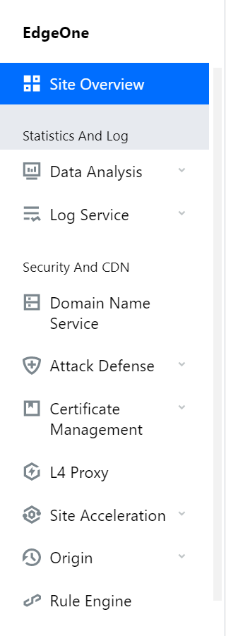
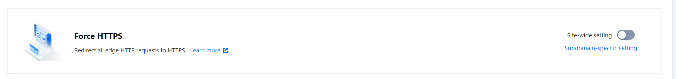
Integrated console for simpler, faster, and easier operations
Individual Tencent Cloud products
EdgeOne
1 console
Supports simultaneously viewing
acceleration and security data
Total: 13 steps
Only 3 steps
Connection steps
Product | CDN | DDoS | Web
Number of steps | 4 | 4 | 5
1. Site information input | 2. DNS configuration | 3. Site configuration
1. Domain name connection
2. Local verification testing
3. DNS modification and verification
4. Security group configuration
5. Verification and testing
1. Domain name connection
2. Domain name configuration
3. Origin configuration
4. Service configuration
1. Forwarding rule configuration
2. Origin-pull IP range allowing
3. Local configuration verification
4. DNS modification
Total: 36 items
Only 10 items
Each global configuration item can be enabled with a simple switch,
which is more lightweight and easier to view and use.
Same features, simpler operations
Configuration faster by 3 times
  Features
Product | CDN | DDoS | Web | Bot
Categories | 8 | 11 | 9 | 8
1. Domain name management
2. Domain name configuration
3. Statistical analysis
4. Purge and prefetch
5. Log service
6. Plugin center
7. Secure acceleration
8. Service query
1. DDoS protection level
2. Protocol blocking
3. Watermark protection
4. Feature filtering
5. AI protection
6. Exceptional connection protection
7. IP access control list
8. Port filtering
9. Blocking by location
10. IP port rate limiting
11. Connection attack protection
1. Rule engine
2. AI engine
3. IP blocking penalty
4. Access control
5. Regional blocking
6. CC protection rule
7. Webpage tamper protection
8. Information leakage protection
9. API security
1. Client risk identification
2. Smart analysis
3. - AI assessment
4. - Threat intelligence
5. - Smart statistics
6. - Action settings
7. Traffic analysis
8. Business security settings

Slide 26
Fast and professional aftersales team
Premium tailor-made services
Sincere service experience
Tencent Cloud engineers have a higher degree of acceptance and offer more comprehensive support to different types of customers in diverse scenarios.
According to Gartner Peer Insights 'Voice of the Customer': CDN Services released by Gartner, Tencent Cloud CDN enjoys a 93% willingness to recommend in terms of customer satisfaction, outperforming other CDN service providers.
Custom alarms with real-time responsiveness
Custom self-service console
Custom APIs
Dedicated technical support team
24/7 professional support
Monthly customer-level service report
24/7 security emergency response mechanism in the US and Singapore
Comprehensive and fast response methods
Dedicated personnel for on-site support
Real-time IM response (Slack/QQ)
Hotline
Email
Online ticket
Multi-lingual support
On-site support for major events
Examples: National holidays and Black Friday
*Some vendors are slow in Ops and response and cannot respond to urgent customer needs, such as resource scheduling updates and urgent game version updates.

Slide 27
04
Case Sharing

Slide 28
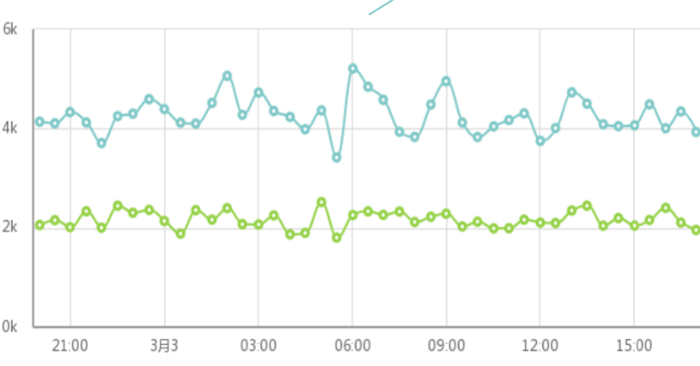
Gaming Industry
Business benefits
Case 1：Download Acceleration
The overall performance is improved by about 47%, and the average transmission speed is doubled
After connecting to Tencent Cloud CDN, the download success rate increased to 99%
Tencent Cloud Anti-DDoS security products ensure the stable operation of the game platform
Background
A well-known online game operating company in Southeast Asia, Hong Kong, Macao and Taiwan
The game platform is the largest online game platform with millions of active users in Southeast Asia, Hong Kong, Macau and Taiwan.
Business Objective
With Tencent solution, the transmission speed was significantly improved
Provide stable and high-quality download acceleration to ensure extremely fast download experience for users around the world. Protect the game platform, ensures stable access of game player, and resists large network attacks.
Tencent Solution
Support multiple purge and pre-warm schemes for large content update, such as game package download, mobile phone ROM upgrade, etc,
Fast and stable download experience with elastic high bandwidth reserves, enough capacity to deliver sudden peak traffic.
Integrate with Anti-DDoS security products, provide global protection against volumetric DDoS attacks, and ensure stable access for players.
Average transfer speed

Slide 29
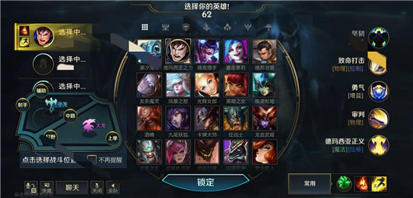
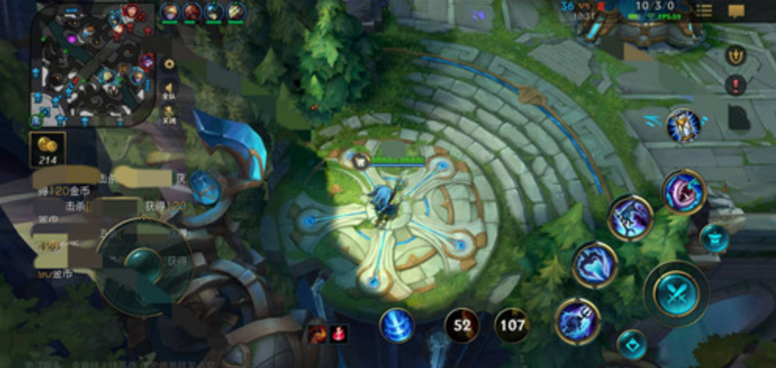
Gaming Industry
Business benefits
Case2：DDoS Mitigation for Game Servers
The new game has been running stable, with more than 107 DDoS attacks mitigated successfully within half a year of its launch.
At present, the game is running safe and stable, received rave reviews from players
Background
An US online game developer, the representative game has more than 27 million views and activities from players every day.
Business objective
The popularity of the game caused hackers' attacks to the lobby servers of the majority of game customers. The game platform urgently needed a comprehensive DDoS mitigation solution against attacks.
Tencent Solution
Use Tencent Cloud anti-DDoS products to protect game hall servers in Frankfurt and Singapore
Using Anti-DDoS products with smart scheduling to mitigate volumetric attacks on lobby servers
Provided enhanced SLA service and specialist technical assistance during esports events.

Slide 30


Gaming Industry
Case3：Resource exhaustion attack mitigation Protection against malicious account activities
Business benefits
Background
New game release Web protection status:
1.The highest peak qps: 6611qps
2.Number of protected domain names: 13
3.Connection exhaustion attacks mitigated.
During this period, the web protection works well. Gaming service has been stable throughout the launch event.
One of China's biggest online game developers and operators was launching its new game online, and introducing promotion events on the day of launch.
Business objective
Reduce or mitigate junk traffic access, reduce server and bandwidth consumption from malicious access
Protection against connection exhaustion attacks
Restrict and block high-frequency access behavior
Bot attack prevention, blocking Bot swipe and recharge activity interface
Integrate with Anti-DDoS products, securing Both lobby servers and battle servers
Tencent Solution
Use Rate Limiting policies to control session-based frequency, prompting human verification on most frequently-requesting clients
Use Bot management to identify crawler and Bot behaviors analyzing to reduce spam traffic.
Use Anti-DDoS products to mitigate various DDoS attacks during early days of game launch

Slide 31
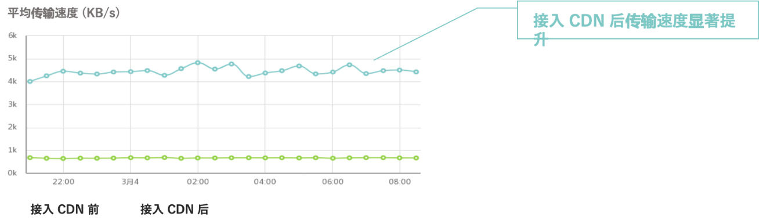


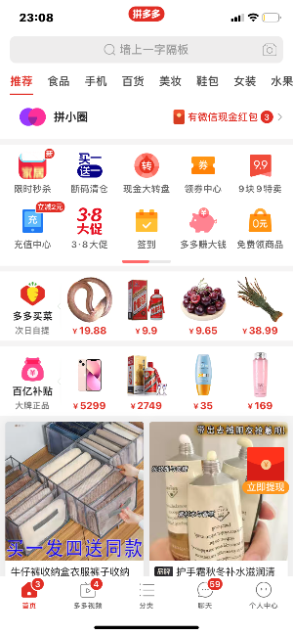
E-commerce/New Retail
Business benefits
方案效果
Case 1：Static content acceleration
The overall business performance increased by about 66%, and the average transmission speed increased by about 6 times.
Promotion event during Spring Festival and Double 11 were successfully delivered, with all services stable without issue.
Background
A domestic TOP3 e-commerce APP with 580 million active buyers, GMV of 1,006.6 billion yuan, and 19.7 billion parcel orders
Average transfer speed
With Tencent solution, the transmission speed was significantly improved
Business objective
Accelerate the distribution of static content in business sites, optimize and improve user access experience, provide key guarantees during events such as the Spring Festival and Double Eleven, and protect core services
Tencent Solution
Powerful global acceleration capability of website static content
Greatly reduces site response time, realizes high-speed loading of complex content, and improves web user experience
Effectively protect Bot traffic, prevent resource preemption in large-scale marketing activities, and prevent sales and prices from being crawled by opponents
Promotion events were protected by Anti-DDoS security products, ensuring availability of core services.

Slide 32

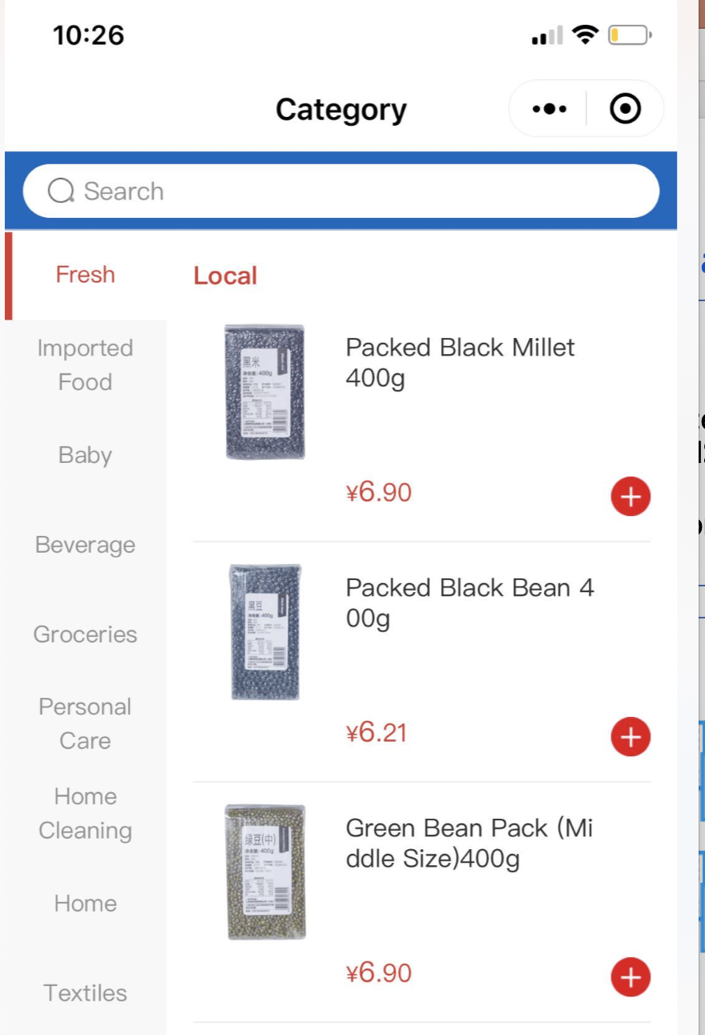
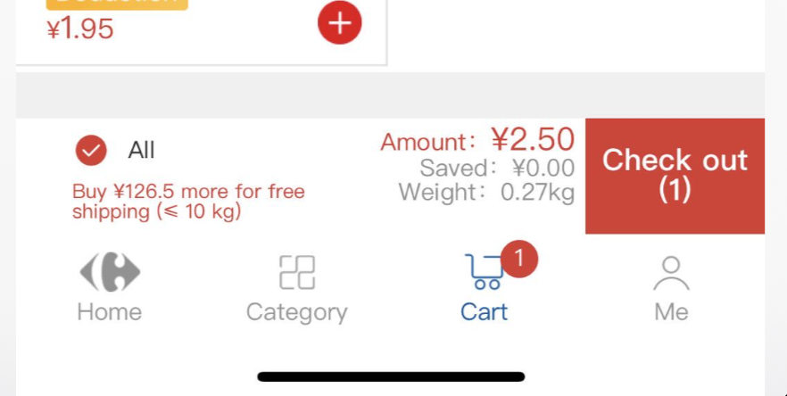
E-commerce/New Retail
Business benefits
Case2: Access Restriction/Bot Management
Implement user-level access restrictions instead of IP-level access restrictions
Identify and block malicious behaviors of resource consumption interfaces and marketing interfaces to protect websites
Observing user behavior, determining malicious patterns, and assisting in optimizing customer logic
Background
One of the domestic traditional retail giants, which is constantly promoting the transformation of smart retail, and is a typical all in cloud customer of e-commerce and smart retail.
Business objective
Important website interfaces (such as shopping cart, payment, order, SMS, etc.) prevent malicious attacks and swiping
Anti-crawling requirements to protect transaction records, product details and price information
Bot behavior analysis, distinguish between human and machine access to the website, and deal with malicious access behavior. activity guarantee, stability guarantee
Tencent Solution
Use intelligent rate limit policy to restrict access based on user information such as request parameters and cookies.
Use Bot behavior management to provide a variety of countermeasures to deal with malicious Bots and protect normal business services
Greatly reduces site response time, realizes high-speed loading of complex content, and improves web user experience

Slide 33
Finance
Background
Case：Intelligent acceleration with
DDoS mitigation and Web Protection
protection
Online banking, aiming at inclusive finance, is committed to serving the working class, freelancers, migrant workers, as well as small and micro enterprises and start-ups. Such services are strictly regulated by governments.
Business objective
Tencent Solution
Business benefits
Intelligent acceleration
Guarantee network access quality
Guarantee the stable operation of customer business
Full link service, 7*24 hours uninterrupted service
Multi-dimensional guarantee of website service stability
The average latency of the public network is reduced from 100ms to 20ms
Based on regulatory requirements and business stability
Sensitive services require strict security and stability
Inaccessible services shall cause financial losses
Brand name and customer's trust tied with service availability
Provide DDoS protection services for customers' full range of businesses to ensure the rapid development of customers' businesses
DDoS Mitigation
No need to change service configurations
Basic + Elastic Protection Package
Web Protection
Protection
Support IPv6, access visual monitoring
Flexible security rule customization
Log secondary analysis, threat data mining
Activity guarantee, net escort
Based on AI + rule dual engine, anti-bypass, low false positives, accurate and effective defense against OWASP-defined web security threat attacks
Tencent expert team on-site service
During the attack mitigation drill, 0 point was lost. Service availability was successfully .
Effectively prevent 100+ domain names to ensure normal Web services
Effectively block 2 million+ attacks every day

Slide 34
OTT
Case 1：Audio and video acceleration
Tencent Solution
Background
Supports a variety of audio and video transmission protocols, relying on Tencent's years of online video operation experience, to ensure the availability of services at high concurrency, and to improve the real-time transmission speed of media files
Support file pre-pulling to provide users with a stable and smooth viewing experience
Support the identification and protection of malicious traffic, prevent malicious video traffic from being swiped, and protect copyright
A well-known Internet video platform provides high-definition video-on-demand services for all its TV columns, and synchronously pushes popular TV series, movies, variety shows and music video content, as well as synchronous live broadcast of some TV stations.
Business objective
Business benefits
Guarantee service availability and audio and video transmission speed, provide users with a stable online viewing experience, ensure that services are not attacked by Bots, and prevent malicious traffic from resource consumption and content piracy.
50% improvement in customer service resource response time and approximately 42% reduction in first play time
Task | Availability(%) | Errors (times) | Average download speed (KB/s) | First play time(s) | DNS time (s) | TCP time (s) | Response time (s) | SSL time (s) | Download (KB) | Effective monitoring (times)
After | 99.54 | 6 | 393.521 | 0.923 | 0.077 | 0.155 | 0.057 | 0 | 23,082.688 | 1311
Before | 99.02 | 13 | 375.324 | 1.593 | 0.072 | 0.255 | 0.114 | 0 | 22,015.109 | 1309

Slide 35
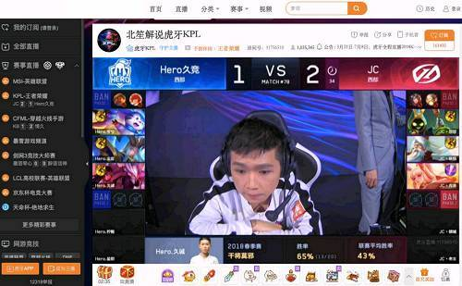
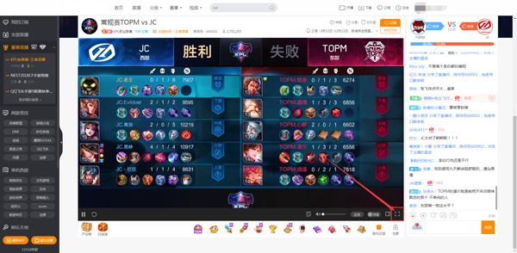
OTT
Business benefits
Case 2：DDoS mitigation
During the IPO time, customer's streaming service was running stable.
Background
An interactive live streaming platform that provides high-definition, smooth and rich interactive live streaming services was going IPO.
Business objective
IPO preparation
Protection against volumetric DDoS attacks
Keep the interactive streaming services accessible and stable
Tencent Solution
Use Anti-DDoS products as security solution：
Surgical integration: service running smoothly while solution deployed
Tailored solution to protect HTTPS Web Protection ;
Proactive defense strategy: custom DDoS mitigation policy based on the number of client IP connections;

Slide 36
Traditional Business
Case：Intelligent acceleration + DDoS/Bot/Web protection
Background
Tencent Solution
A leading express logistics company whose business involves express delivery, warehousing, supply chain, etc. Hundreds of IT systems are used, and security reinforcement of external service websites and internal systems is required.
Access services to customers' external websites, information query systems, and customers' internal IT systems (including CRM systems, terminal platform systems, etc.), providing customers with DDoS cleaning, precise access control, Web protection, Bot Management, and attack monitoring services to protect customers Business Availability and Data Information Security.
Only the service domain name is exposed to the outside world
Business objective
Prevent user-oriented websites and business query systems from being tampered with or implanted with malicious scripts
Avoid public IP exposure, hackers directly attack the user source server
Prevent logistics-related data from being maliciously crawled, resulting in data risks and bandwidth waste
Avoid the unavailability of site services exposed by customers to the Internet due to DDoS attacks
Guarantee the overall service performance of the business, and there will be no freezes, etc.
Business benefits
Protect the stable availability of customer websites and customer-facing internal and external IT services
Identify and block malicious access, reduce bandwidth and server abuse, and avoid data theft
Protect the public network IP from being leaked, and ensure the security of the client source server from the architecture.

Slide 37
Thank You!

